Slide 1
ULUSLARARASI PROJE YÖNETİMİ KOORDİNATÖRLÜĞÜ Weiterbildung

Slide 4
What is GNE?
Gesellschaft für Nachhaltige Entwicklung (Society for Sustainable Development) is a non-profit educational institute specialized in sustainability topics.
The company's goal is the promotion of sustainable management and sustainable technologies through further education or capacity building measures in the areas of:
- Development cooperation and humanitarian aid
- Nature conservation and environmental protection
- Climate protection
- Social inclusion (Sosyal içerme ) and youth work
- resource management
- Biodiversity and ecological agriculture (Biyoçeşitlilik ve ekolojik tarım)

Slide 5
Kurslar ve Seminerlerin Dili B1 Almanca & Ingilizce (aim to reach B2/C1)
Coordinator in International Project Management (IPM) – English
Coordinator in International Climate Protection & Adaptation (CPA) – English
Coordinator for climate protection & resource management (KUR) – German
Coordinator for Renewable Energies & Energy Management (KEE) – German
Coordinator in Monitoring & Evaluation (M&E) – English
Language of instruction is English, but some parts will be conducted in German!
Ortak ders..

Slide 6
JobCenter Desteği
Her program ‘Agentur für Arbeit’ ve ‘JobCenter’ (ALG I veya ALG II Bildungsgutschein ) tarafından desteklenmektedir

Slide 7
The next start for the courses: May 2nd till November 30th, 2022 All courses starting at the same time.
Program phases for this period:
I. Seminars: May 02, 2022 - August 26, 2022 (12w)
II. Internship: 29 August 2022 - 25 November 2022 (9w)
III. Final week with examination: 28 - 30 November 2022
Internship report*

Slide 8
Int'l Project Management (IPM)

Slide 10
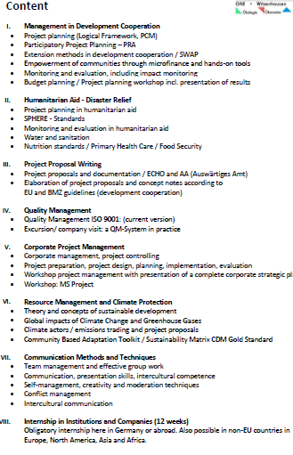
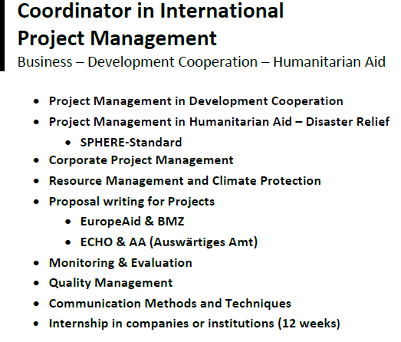
Contents of Coordinator in International Project Management (IPM)

Slide 11
Dersler Nasil Isleniyor
First days/week introduction
Online (Webex) / on site
Introduction / briefing
Workshops
Sample Project proposal writings
Case studies
Presentation of workshops
Question /answers
Tests after every topic.
After Internship: Oral exam and Internship report*

Slide 12
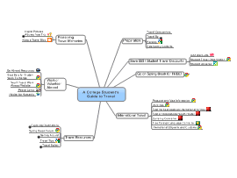
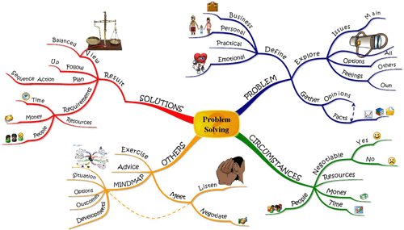
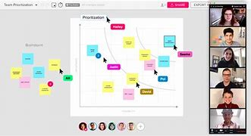
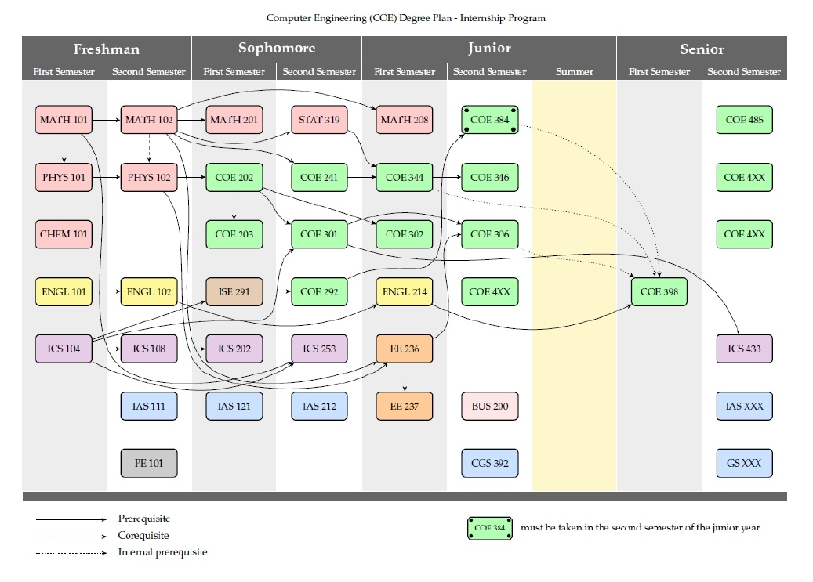
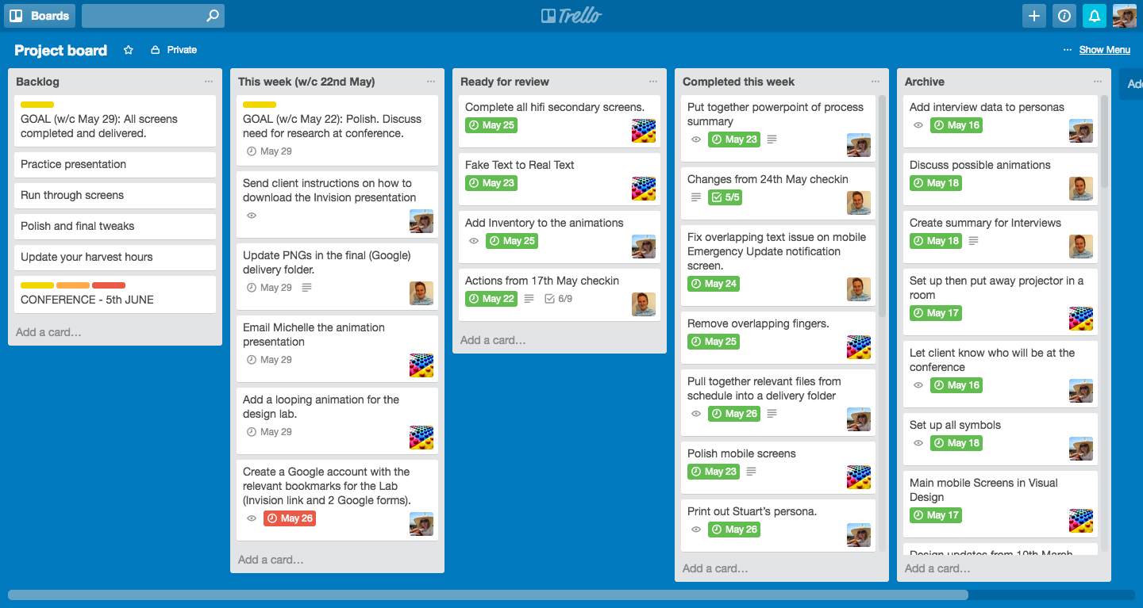
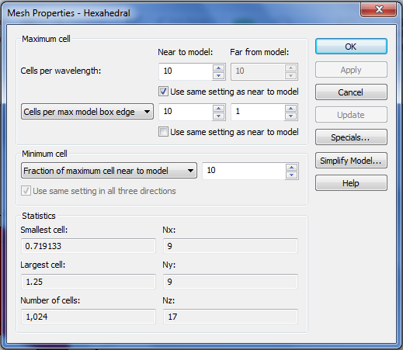
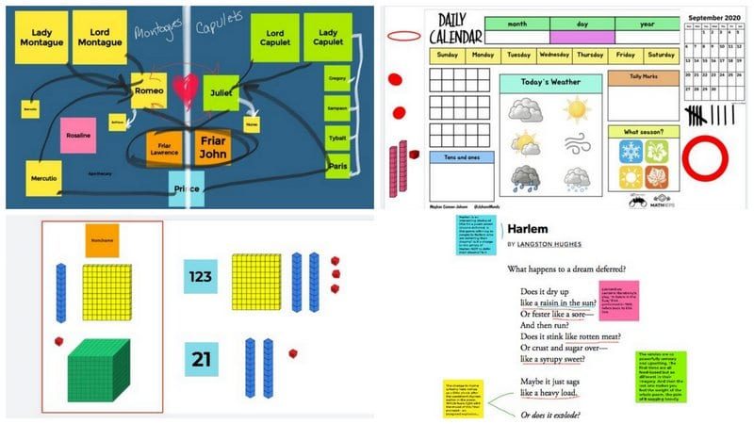
Collaboration Tools Proje Hazirlama ve Workshoplar icin Kullanilan Programlar
Miro
Mural
CryptoDrive
Trello
Dashboard
Winpaccs
Jamboard
Yopad
Kobotoolbox
Excel
Webex
Spatial-Group talk
etc.

Slide 13
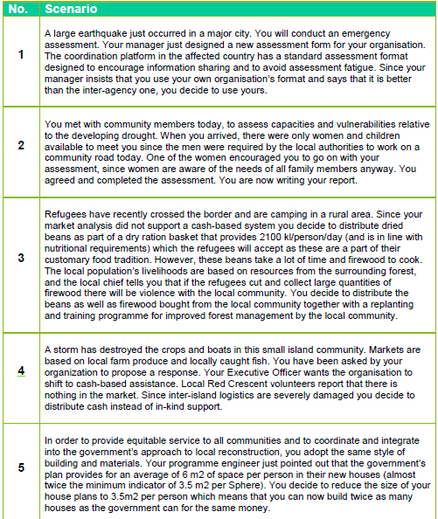
Ornek Bir Case Study:

Slide 14
Ornek Paydas Analizi

Slide 15
Profil olusturma ve kalkinma ajanslariyla paylasma

Slide 16
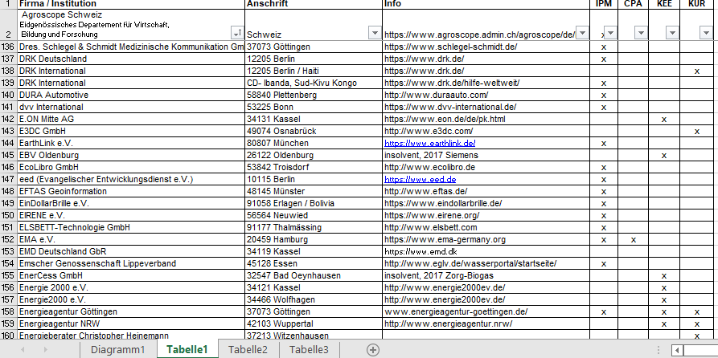
Liste der Praktikumsberichte moodle 2020-09-22xlsx (607 organizations) 1.

Slide 17
2

Slide 18
If Interested:
If someone is interested in participating in these training programs:
1. They should send a short letter of motivation (also in an e-mail)
2. CV with a photo.
3. Then they will receive from GNE an "educational offer - confirmation of participation".
Also the GNE offers the possibility to stay in one of the GNE guest houses for the duration of the training (photos you can find on our website: https://www.gne-witzenhausen.de/gaestehaus/).
No Application Deadline!

Slide 19
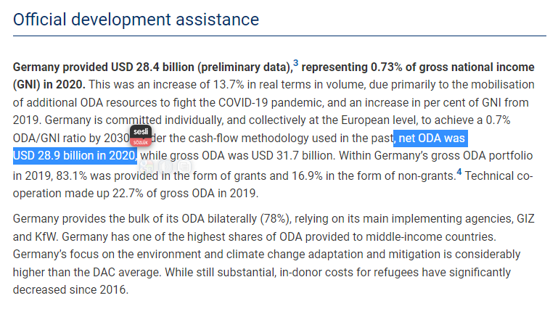
Sources, Job Sites & Partners
1
Moodle: http://moodle.gne-witzenhausen.de/ (show contents)
Website: https://www.gne-witzenhausen.de/ (Uni-Kassel)
Mezunlara gonderilen is ilanlari

Slide 20
2

Slide 21
From Moodle

Slide 22
2010-2020 arasi mezunlarin istihdam orani

Slide 23
Thank you :)

